Slide 1
Wet Waste-to-Energy Feedstock Supply Curves
Alex Badgett, Emily Newes, Anelia Milbrandt
August 1, 2017

Slide 2
Sludge

Slide 3
Sewage Sludge Process Flow
Landfill
Primary & Secondary Treatment
Dewatering
Hauling
Land Application
Storage
Incineration
Added Costs
Avoided Costs
EPA cost models¹ for sludge management techniques were digitized and costs updated for inflation
Sludge used will be primary or secondary²
¹“Handbook: Estimating Sludge Management Costs.” 1985. EPA/625/6-85/010. United States Environmental Protection Agency.
²Snowden-Swan, LJ, Y Zhu, SB Jones, DC Elliott, AJ Schmidt, RT Hallen, JM Billing, TR Hart, SP Fox, and GD Maupin. 2016. “Hydrothermal Liqefaction and Upgrading of Municipal Wastewater Treatment Plant Sludge: A Preliminary Techno-Economic Analysis.” PNNL-25464. Pacific Northwest National Laboratory.
Notes:
This is the modeled sludge process flow, showing the avoided costs and additional costs experienced if diverting sludge for WtE use. It should be noted that many POTWs already use dewatering technologies to reduce the amount of biosolids being produced and to reduce the cost of transporting them.

Slide 4
Sewage Sludge Supply Curves
¹“Handbook: Estimating Sludge Management Costs.” 1985. EPA/625/6-85/010. United States Environmental Protection Agency.
²Seiple, Timothy E., Andre M. Coleman, and Richard L. Skaggs. 2017. “Municipal Wastewater Sludge as a Sustainable Bioresource in the United States.” Journal of Environmental Management 197: 673–80.
Notes:
Supply curves created with two different sources of data:
-Production values sourced from PNNL study quantifying the amounts of sludge produced across the united states. Production of primary and secondary sludge was provided for each state.
-Cost of individual components of the wastewater treatment process was determined based on EPA economic models. Models give cost per ton of each process as a function of plant inflow. These costs were modeled based on a POTW inflow of 50 MGD. Component costs were added/subtracted as shown in the equation on the next slide.
Real cost data was compiled and graphed in conjunction with the PNNL production data. This method of verification is subject to lots of variance in available data. Some states average the cost of disposal across all POTWs, while some state values had to be based on information for a single plant within the state.

Slide 5
Sewage Sludge Supply Curves
¹“Handbook: Estimating Sludge Management Costs.” 1985. EPA/625/6-85/010. United States Environmental Protection Agency.
²Seiple, Timothy E., Andre M. Coleman, and Richard L. Skaggs. 2017. “Municipal Wastewater Sludge as a Sustainable Bioresource in the United States.” Journal of Environmental Management 197: 673–80.
Notes:
Supply curves created with two different sources of data:
-Production values sourced from PNNL study quantifying the amounts of sludge produced across the united states. Production of primary and secondary sludge was provided for each state.
-Cost of individual components of the wastewater treatment process was determined based on EPA economic models. Models give cost per ton of each process as a function of plant inflow. These costs were modeled based on a POTW inflow of 50 MGD. Component costs were added/subtracted as shown in the equation on the next slide.
Real cost data was compiled and graphed in conjunction with the PNNL production data. This method of verification is subject to lots of variance in available data. Some states average the cost of disposal across all POTWs, while some state values had to be based on information for a single plant within the state.

Slide 6
Supply Curve Construction: Sewage Sludge
The assumed sludge process flow is likely to vary between plants, with some employing alternative treatment technologies not considered in the cost model
Model currently assumes sludge is hauled to a landfill for disposal, however many states land apply or incinerate
Sludge hauling distance assumed to be 100 miles
Dewatering and storage facilities may or may not already be included in plant operational costs
Future work: regionalizing disposal methods, understanding currently deployed dewatering and storage technologies by region
Snowden-Swan, LJ, Y Zhu, SB Jones, DC Elliott, AJ Schmidt, RT Hallen, JM Billing, TR Hart, SP Fox, and GD Maupin. 2016. “Hydrothermal Liqefaction and Upgrading of Municipal Wastewater Treatment Plant Sludge: A Preliminary Techno-Economic Analysis.” PNNL-25464. Pacific Northwest National Laboratory. http://www.pnnl.gov/main/publications/external/technical_reports/PNNL-25464.pdf.

Slide 7
Food Waste

Slide 8
Food Waste Process Flow
Landfill
Collection
Transfer Station
(Sorting)
WTE -Incineration
Avoided Cost
Compost
De-packaging/Slurry Development
WTE-AD
Added Costs
Material will be diverted at transfer station or other intermediate facility
Sorting and pre-processing of organics is necessary prior to its use as a WtE feedstock in states without organic waste bans

Slide 9
Food Waste Supply Curve
Nishtala, Subba, and Eric Solano-Mora. 1997. “Description of the Material Recovery Facilities Process Model: Design, Cost and Life-Cycle Inventory.” Research Triangle Institute. https://mswdst.rti.org/docs/MRF_Model_OCR.pdf.
“Summary of Food De-Packaging Technologies.” 2014. Recycling Works Massachusetts.

Slide 10
Supply Curve Construction: Food Waste
States with organic waste bans are presumed to have sorting costs equal to zero
Very little literature exists on the cost of organics sorting facilities-costs were assumed to be similar to recycling facilities (MRFs)¹
Once sorted, organics were depackaged and blended into a slurry, considered as an additional cost
Future work: refine sorting cost model to reflect organics processing, validate with economic values from literature
¹Robert Hallenbeck, Personal Communication
^{2”}Summary of Food De-Packaging Technologies.” 2014. Recycling Works Massachusetts.

Slide 11
Fats, Oils and Greases (FOG)

Slide 12
FOG Supply Curve

Slide 13
Supply Curve Construction: FOG
Used national production and price – could disaggregate to state-level
Price does not vary greatly by region
There is no additional supply to satisfy higher demand (even at a higher price).
Sources:
Milbrandt, A. Seiple, T., Heimiller, D., Coleman, A., Skaggs, R. (2017). “Wet Waste-to-Energy Resource Assessment”. Pending publication. Biomass and Bioenergy Journal.
Smith, D. (2017). Baker Commodities, Personal Communication.
Swisher, K. (2016). Market Report. Renderer Magazine. April 2016. http://pubs.rendermagazine.com/2016-04/pubData/source/Render_Apr16.pdf
Wang, Lijun. (2014)."Food Processing Wastes as an Energy Feedstock: Availability and Sustainability." Sustainable Bioenergy Production. Boca Raton: CRC, Taylor & Francis

Slide 14
Manure

Slide 15
Manure Process Flow
Avoided Costs
Collection
Storage
Transportation
Land Application
For swine: solid, slurry or lagoon
Sale to Outside Consumers
Sources:
Bentley, J., Tranel, L. (2015). “Calculating manure’s price tag”. Hoard’s Dairyman. July 2015. http://hoards.com/article-16269-calculating-manure%E2%80%99s-price-tag.html
Jordahi, R. (2011). “Manure Matters.” Pork Network. January 2011. http://www.porknetwork.com/pork-magazine/features/manure-matters-114019804.html
MacDonald, J., M. Rivaudo, M. Livingston, J. Beckman, and W. Huang. (2009). “Manure Uses for Fertilizer and for Energy: Report to Congress.”. https://www.ers.usda.gov/webdocs/publications/42731/16739_ap037fm_1_.pdf?v=41055
North Carolina State University. (2004). Project Reports. https://www.bae.ncsu.edu/topic/waste-mgmt-center/agreement.html
North Carolina State University. (2013). “Cost and Returns Analysis of the Terra Blue Generation 3 Manure Management System Evaluated at Jernigan Farms in North Carolina in 2012”. https://www.bae.ncsu.edu/topic//waste-mgmt-center/CWMTF-report/CWMTF%20Report%20Appendix%20B.2006A-522%20Final%20Report.pdf

Slide 16
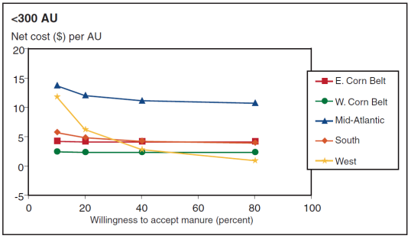
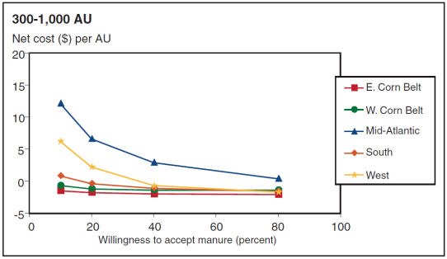
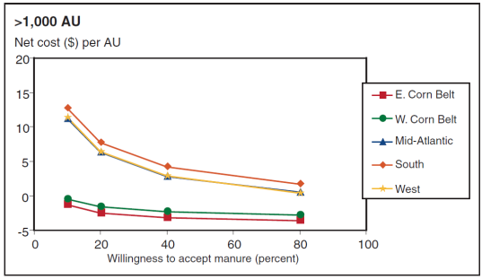
Supply Curve Construction: Manure
AU = Animal Unit

Slide 17
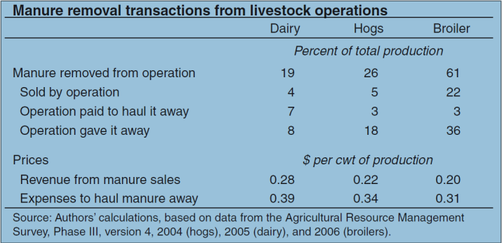
Supply Curve Construction: Manure
Only 20% of nearby farms will accept manure.
Farmers who obtain manure many times only pay for transportation; some are paid to take the manure.

Slide 18
Supply Curve Construction: Manure
Dairy Manure
Based on transportation + application costs from Iowa ($6.88/ton) – the farmer will always need to collect and store the manure
Labor is only 17% of costs, and it is the main factor that varies among states.
However, we need to gain a better understanding around the value of application to dairy farmers
The cost of moving and storing manure is $4.44/ton
Price of manure in Iowa is $2-4/ton
5% of dairy farms remove any manure from the farm
19% of all manure is removed
Farms in the largest class (2,000 animal units, about 1,500 cows) remove nearly half of their manure.

Slide 19
Supply Curve Construction: Manure
Swine Manure
22% of market hog production occurs on farms without crops.
16% of farms remove manure
26% of all manure is removed
The largest operations (at least 1,000 animal units, or 6,000-7,000 market hogs removed in a year) remove 1/3 of all the manure generated on the farm.

Slide 20
Next Steps

Slide 21
Next Steps
FY2017 (September 2017)
Finalize national supply curves and explore appropriate regionalization
Vet supply curves with industry experts
FY17 carryover (December 2017)
Create regional supply curves
FY18?
Supply curve projections and scenarios

Slide 22
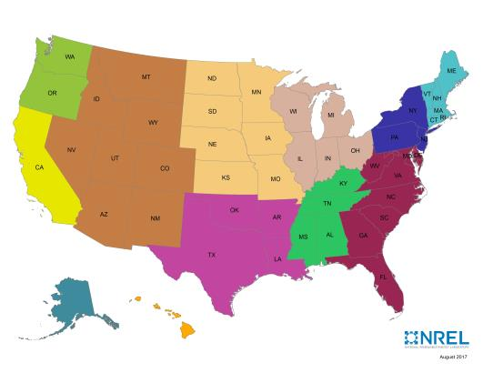
Possible Regionalization of Supply Curves
Every effort will be made to generate state-level supply curves
Initial approach will be to work with the identified 12 regions
FOG may present a challenge as there is not much difference in prices between states.
Proposed Regions for WTE Feedstock Supply Curves

Slide 23
Acknowledgments
Special thanks to the following individuals for their contributions to this work:
Greg Kester, California Association of Sanitation Agencies
Mark Rice and Kelly Zering, North Carolina State University
Larry Tranel, Iowa State University
Mark Stoermann, Newtrient LLC
Doug Smith, Baker Commodities, Inc.
Wendy Barrott, Great Lakes Water Authority
John Hake, EBMUD
Robert Hallenbeck, Waste Management

Slide 24
Thank you!

